Slide 1

IBM Data Analyst Capstone Project
Sumant Chakravarty
Date-6.03.2026

Slide 2



OUTLINE
Executive Summary
Introduction
Methodology
Results
Visualization – Charts
Dashboard
Discussion
Findings & Implications
Conclusion
Appendix

Slide 3

EXECUTIVE SUMMARY
The primary objective of this project was to identify emerging trends in programming languages, databases, and professional demographics to understand the shifting landscape of the IT industry.
Summarize key findings here
1. Programming Language Trends
Current Leaders: JavaScript, HTML/CSS, and SQL remain the most widely used languages in the industry.
Future Growth: Python is the fastest-growing major language and is projected to potentially overtake JavaScript in popularity. TypeScript is also seeing a significant rise in demand for the coming year.
2. Database Trends
Current Usage: MySQL and Microsoft SQL Server are the most commonly used databases.
Future Shift: There is a clear trend toward open-source and NoSQL solutions. PostgreSQL and MongoDB are the most "wanted" databases by developers, indicating a shift away from traditional relational systems like SQLite for new projects.
3. Developer Demographics
Age & Education: The majority of respondents are in the 18–34 age bracket, and approximately three-fourths of developers hold at least a Bachelor’s degree.
Gender Gap: The analysis highlights a significant gender disparity in the tech field, with roughly 90% of respondents identifying as male, suggesting a critical need for diversity and inclusion initiatives.
4. Platforms & Tools
Operating Systems: Linux and Windows are the most common platforms.
Cloud Adoption: Major cloud platforms like AWS, Azure, and Google Cloud remain in high demand as companies move toward scalable infrastructure.

Slide 4

INTRODUCTION
The project is based on the 2019 Stack Overflow Developer Survey and typically includes the following key findings:
1. Purpose of the Report
The primary purpose of this report is to provide a comprehensive, data-driven analysis of the global technology landscape to identify current and future industry trends. By analyzing large-scale datasets (primarily the Stack Overflow Developer Survey), the report seeks to:
Identify Skill Gaps: Determine which programming languages and technologies are currently dominant and which are emerging as future industry standards.
Track Market Shifts: Monitor the transition from traditional technologies (like relational databases) to modern paradigms (like NoSQL and Cloud-native platforms).
Analyze Demographics: Understand the composition of the global developer workforce to address diversity, education, and experience levels.
2. Target Audience
The insights generated in this report are designed for stakeholders who need to make strategic decisions based on the direction of the IT industry:
Human Resources & Recruiters: To understand which skills are in high demand and how to structure competitive job offers and training programs.
CTOs and IT Managers: To decide which technology stacks to adopt for new projects and where to allocate budget for infrastructure (e.g., Cloud services vs. On-premise).
Aspiring Data Analysts/Developers: To identify which tools and languages (like Python, SQL, or MongoDB) they should learn to remain competitive in the job market.
Educational Institutions: To align their curriculum with the actual needs of the tech industry

Slide 5
INTRODUCTION
3. Value of the Analysis
The value of this project lies in transforming raw, unstructured survey data into actionable business intelligence. Key value drivers include:
Future-Proofing: By identifying "Wanted" vs. "Worked With" technologies, the analysis predicts future market dominance. For example, seeing the high "want" for Python and PostgreSQL allows companies to begin transitioning before their current tech becomes obsolete.
Strategic Recruitment: The demographic analysis provides a benchmark for diversity and salary expectations. Knowing that the majority of the workforce is in a specific age or education bracket helps companies tailor their culture and benefits.
Cost Efficiency: By understanding platform trends (such as the shift toward specific Cloud providers), organizations can avoid investing in legacy systems that lack community support or developer interest.
Data Integrity: The project demonstrates the value of the Data Analytics Lifecycle—from scraping and cleaning data to visualizing it—ensuring that the conclusions are based on verified, "tidy" data rather than gut feeling.

Slide 6

METHODOLOGY
Methodology Used in the Project
To arrive at these insights, the project follows a standard data analytics lifecycle:
Data Collection: Gathering data through APIs and Web Scraping.
Data Wrangling: Cleaning the dataset by removing duplicates, handling missing values, and normalizing salary data.
Exploratory Data Analysis (EDA): Using SQL and Python (Pandas/Matplotlib) to find correlations and distributions.
Interactive Dashboards: Building visual reports using IBM Cognos Analytics to present findings to stakeholders.

Slide 7

Results

Slide 8
JOB POSTINGS

Slide 9
POPULAR LANGUAGES

Slide 10
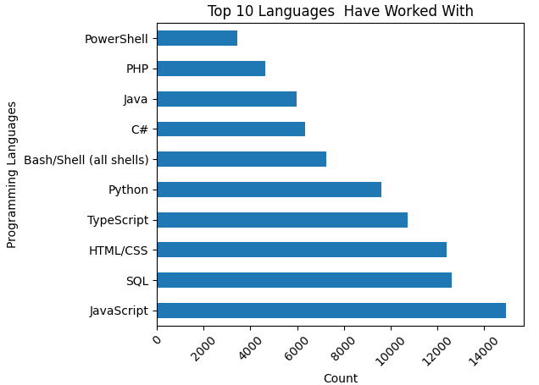
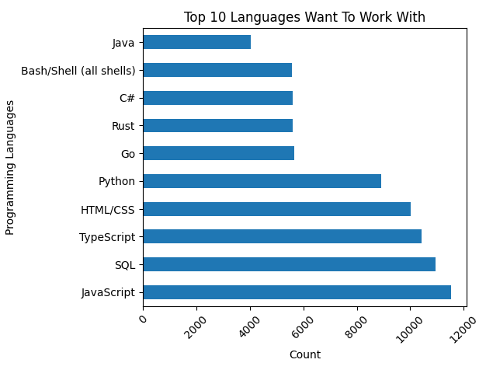
PROGRAMMING LANGUAGE TRENDS
Summarize key trends shown in the charts.
Current Year
Next Year

Slide 11
PROGRAMMING LANGUAGE TRENDS - FINDINGS & IMPLICATIONS
Findings:Dominance of Web Technologies: JavaScript (11,541), TypeScript (10,437), and HTML/CSS (10,016) are among the most desired languages, indicating a continued strong interest in web development, especially with modern front-end frameworks and type-safe JavaScript.
Persistent Importance of SQL: SQL (10,944) ranks very high, underscoring its foundational role in data management and its perennial relevance across various domains.
Python's Versatility: Python (8,919) remains a top choice, reflecting its widespread use in data science, machine learning, web development, and automation.
Emerging System Languages: Go (5,661) and Rust (5,597) show significant interest. This suggests a growing desire among developers for languages that offer performance, concurrency, and memory safety, particularly for systems programming, microservices, and high-performance applications.
Enterprise and Scripting Languages: C# (5,590) and Java (4,048) continue to attract interest, likely due to their strong presence in enterprise environments, while Bash/Shell (5,582) indicates the ongoing need for scripting and automation.
Implications:
Career Opportunities: Developers looking to stay competitive or transition into new roles might benefit from focusing on these high-demand languages.
Educational Trends: Educational institutions and online learning platforms should consider offering robust courses and resources for these languages to meet market demand.
Hiring Strategies: Companies seeking to build future-proof applications should look for talent proficient in these desired languages.
Technology Adoption: The strong interest in Go and Rust could signal a shift towards more performant and secure systems, influencing future architecture decisions.
Tooling and Ecosystem Development: The popularity of these languages drives further development in their respective ecosystems, including libraries, frameworks, and developer tools.
Findings
Top 10 Platforms Have Worked With (from executed code):
Amazon Web Services (AWS) is the most widely used platform among the respondents by a significant margin (600 counts).
Microsoft Azure (383 counts) and Google Cloud (317 counts) are the next most popular, indicating that the major cloud providers dominate the market for platforms developers have experience with.
Other platforms like Cloudflare, Digital Ocean, Firebase, Vercel, Netlify, and Heroku are also represented, showing a diverse ecosystem of platforms, though with lower counts compared to the top three cloud providers.

Slide 12
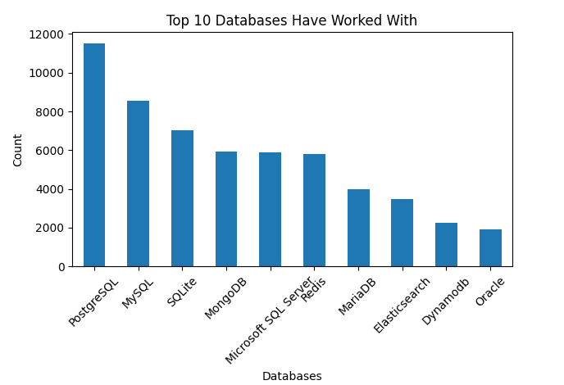
DATABASE TRENDS
Summarize key trends shown in the charts.
Current Year
Next Year

Slide 13
DATABASE TRENDS - FINDINGS & IMPLICATIONS
Findings
The 'Top 10 Databases Have Worked With' chart, generated from the survey data, reveals the most popular databases among the respondents. Here's a breakdown of the top databases:
PostgreSQL: 5601 respondents
MySQL: 4118 respondents
SQLite: 3404 respondents
MongoDB: 2907 respondents
Redis: 2884 respondents
Microsoft SQL Server: 2809 respondents
MariaDB: 1910 respondents
Elasticsearch: 1706 respondents
Dynamodb: 1133 respondents
Oracle: 835 respondents
This indicates that relational databases like PostgreSQL and MySQL are highly prevalent, while NoSQL options like MongoDB and Redis also have a significant user base.
findings
The 'Top 10 Databases Want To Work With' chart, derived from the survey responses, highlights the databases that professionals are most interested in learning or using in the future. Here's a summary of the top choices:
PostgreSQL: 12193 respondents
Redis: 6384 respondents
SQLite: 6295 respondents
MySQL: 6204 respondents
MongoDB: 5618 respondents
Microsoft SQL Server: 4345 respondents
Elasticsearch: 3665 respondents
MariaDB: 3078 respondents
Dynamodb: 2154 respondents
Supabase: 1623 respondents
This data suggests a strong ongoing interest in relational databases like PostgreSQL and MySQL, but also significant enthusiasm for NoSQL databases such as Redis and MongoDB, as well as cloud-native options like Dynamodb and Supabase.

Slide 14

DASHBOARD
1.Current Technoogy
2. Future Technology Trends
3. Demographics

Slide 15
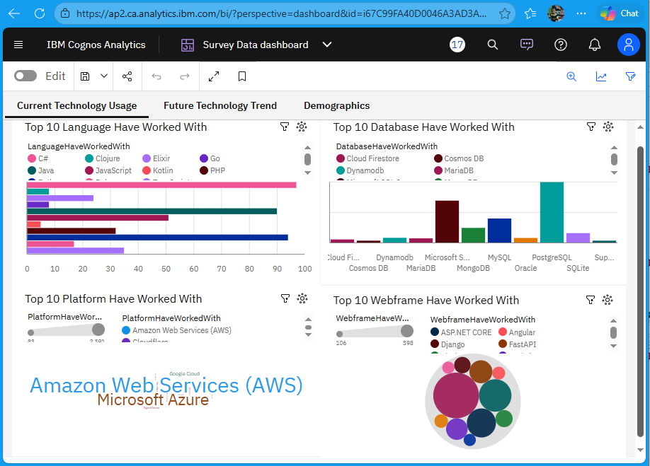
DASHBOARD TAB 1: Current Technology Usage

Slide 16
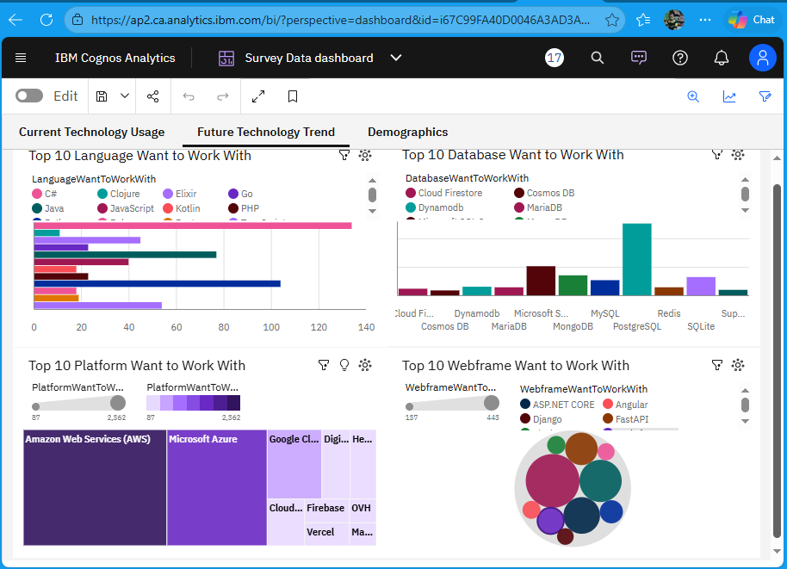
DASHBOARD TAB 2: Future Technology Trends

Slide 17
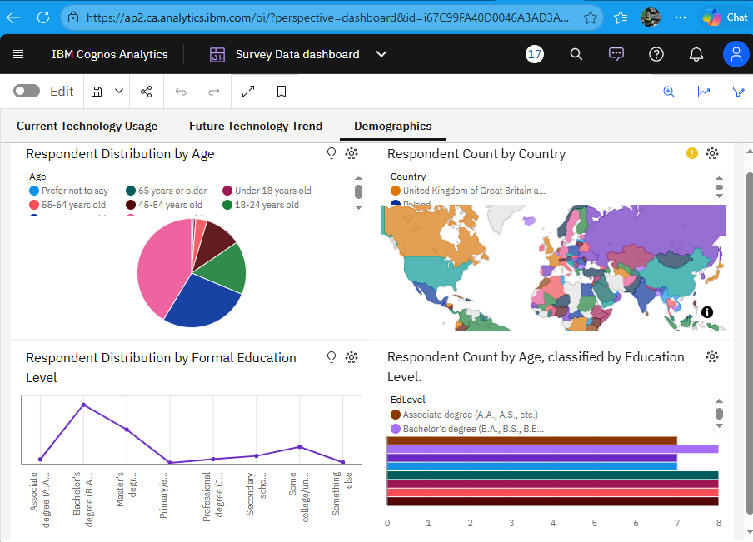
DASHBOARD TAB 3: Demographics

Slide 18
DISCUSSION
https://github.com/Sumant-crty/IBM-Data-Analyst-Capstone-Project/blob/main/Survey%20Data%20dashboard.pdf

Slide 19
OVERALL FINDINGS & IMPLICATIONS
Overall Insights:
Web Development Dominance and Evolution: Languages like JavaScript, HTML/CSS, and TypeScript, along with frameworks like React, Node.js, and Next.js, consistently rank at the top for both current usage and future interest. This signifies the enduring importance and rapid evolution of web technologies, with a strong lean towards modern, component-based, and type-safe development.
Foundational Data Management: SQL remains a cornerstone, consistently appearing as a highly-used and highly-desired skill. PostgreSQL is particularly prominent in the 'want to work with' category for databases, suggesting a preference for robust relational databases. Alongside this, there's growing interest in diverse data stores like Redis (for caching), MongoDB (NoSQL document store), Elasticsearch (search), and cloud-native options like Dynamodb and Supabase, indicating a move towards specialized data solutions.
Cloud-Native is the Present and Future: Major cloud providers (Amazon Web Services (AWS), Microsoft Azure, Google Cloud) overwhelmingly dominate the 'platforms worked with' and 'platforms want to work with' categories. Furthermore, the strong presence of serverless and edge computing platforms like Vercel, Netlify, Cloudflare, and Firebase highlights the industry's shift towards managed services, scalability, and streamlined deployments.
Emerging Focus on Performance and Systems Programming: A notable trend is the significant jump in desire for languages like Go and Rust compared to their current usage. This indicates a growing appetite among developers for technologies that offer high performance, concurrency, and memory safety, essential for building efficient systems and infrastructure.
Maturity and Refinement in Web Frameworks: Unlike languages and databases, the 'Top 10 Web Frameworks Have Worked With' and 'Want To Work With' charts show almost identical results. This suggests that developers are largely satisfied with the current leading frameworks (React, Node.js, Next.js, ASP.NET Core, Vue.js, Angular) and are keen to deepen their expertise within these established ecosystems rather than seeking entirely new paradigms.
Implications:
For Developers: To remain competitive, focusing on modern web development (JavaScript/TypeScript, React/Next.js), strong data management skills (SQL, PostgreSQL, NoSQL), and proficiency with cloud platforms (AWS, Azure, GCP) is crucial. Exploring performance-oriented languages like Go and Rust could provide a significant advantage in specialized roles.
For Businesses and Recruiters: These trends highlight the key technologies to invest in for infrastructure and product development. Hiring strategies should prioritize candidates with expertise in dominant cloud platforms, modern web stacks, and evolving data solutions. Investing in upskilling current teams in these areas will be vital for future-proofing technological capabilities.
For Education and Training: Educational institutions and online learning platforms should continue to emphasize core programming skills while also adapting curricula to include advanced topics in cloud computing, modern web frameworks, and specialized data technologies, as well as introducing languages like Go and Rust to prepare the next generation of developers.

Slide 20

CONCLUSION
1. Programming Languages:
Most Worked With: JavaScript is overwhelmingly the most frequently worked-with programming language, followed by SQL and HTML/CSS. This indicates a strong presence of web development and data handling in the respondents' current work.
Most Want to Work With: Similarly, JavaScript is also the most desired language to work with, reinforcing its importance and continued relevance. Python and TypeScript also feature prominently, suggesting interest in data science, backend development, and scalable application development.
2. Databases:
Most Worked With & Want to Work With: PostgreSQL emerges as the most popular database, both in terms of what respondents have worked with and what they want to work with. Redis, SQLite, MySQL, and MongoDB are also highly prevalent, covering various use cases from relational to NoSQL databases.
3. Platforms:
Most Worked With: Amazon Web Services (AWS) to Work With: AWS again tops the list for platforms respondents want to work with, followed by Microsoft Azure and Google Cloud, showing a consistent preference for the major cloud providers.
4. Web Frameworksis the dominant cloud platform, significantly ahead of Microsoft Azure and Google Cloud. This highlights its market leadership in cloud infrastructure.
Most Want :
Most Worked With & Want to Work With: React and Node.js are the two most prominent web frameworks, both for current experience and future interest. Next.js, ASP.NET Core, and Vue.js also show significant popularity, reflecting trends in modern web development, particularly in front-end and full-stack JavaScript ecosystems.

Slide 21
Overall Trends:
There's a strong consistency between the technologies developers have worked with and those they want to work with. This suggests that many developers are either satisfied with their current tech stack or are actively seeking to deepen their expertise in already familiar popular technologies.
JavaScript and its ecosystem (Node.js, React, Next.js, TypeScript) continue to dominate the web development landscape.
Cloud platforms, especially AWS, are critical components of modern development workflows.
PostgreSQL stands out as a highly preferred database solution.

Slide 22

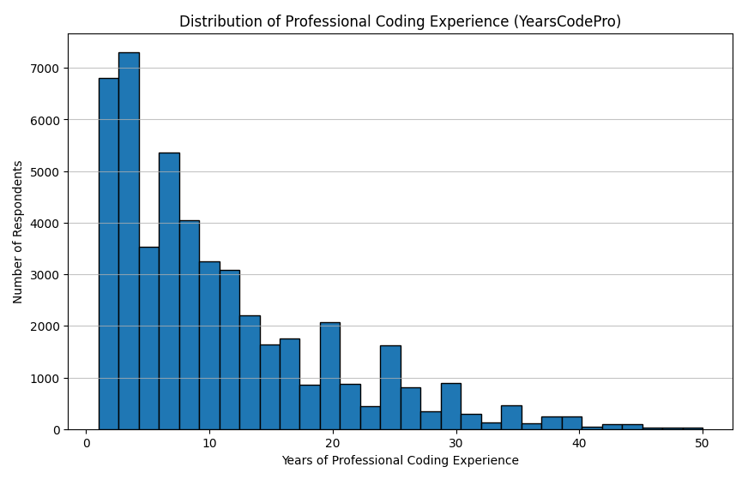
APPENDIX

Slide 23
